Slide 1

MINI PROJECT 2026
Real-Time Public Transport Tracking
for Small Cities
Live GPS-based bus tracking with ML-powered delay prediction, built for the needs of tier-2 and tier-3 city transit systems.
V.S.B Engineering College
Department of Artificial Intelligence and Machine Learning
Developed by: MIDHUN S

Slide 2



Problem Statement
Why small cities struggle with public transport visibility
No Real-Time Visibility
Unpredictable Delays
Limited Infrastructure
Commuters in small cities have no way to know where their bus actually is, leading to long, uncertain waits.
Traffic, weather, and route conditions cause delays with zero advance warning to passengers.
Big-city tracking apps rely on costly infrastructure that small municipal transport systems cannot afford.
Real-Time Public Transport Tracking
2

Slide 3




Project Objectives
What this system aims to deliver
Live location tracking of buses using GPS coordinates on an interactive map
Predict delays in advance using a trained machine learning model
Deliver a simple, responsive dashboard accessible on any device
Improve commuter trust and reduce uncertainty in daily travel
Real-Time Public Transport Tracking
3

Slide 4



System Architecture
How data flows from bus to browser
→
→
→
GPS Data Source
Flask Backend
ML Model
Web Dashboard
Live bus coordinates (lat/long)
app.py processes & serves data
delay_model.pkl predicts delay
index.html + script.js display
Datasets (transport_data.csv) train the model offline; the backend loads it to serve live predictions on each request.
Real-Time Public Transport Tracking
4

Slide 5


Technology Stack
Tools and frameworks used in this project
Frontend
Backend
Machine Learning
Data
HTML5, CSS3, JavaScript (index.html, style.css, script.js) with Leaflet map integration
Python Flask (app.py) serving REST endpoints and model predictions
scikit-learn model (train_model.py, delay_model.pkl) for delay prediction
transport_data.csv — historical bus route and delay dataset
Real-Time Public Transport Tracking
5

Slide 6
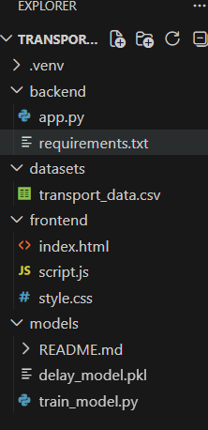

Project Structure
Codebase organization
backend/
app.py — Flask server, requirements.txt
datasets/
transport_data.csv — training data
frontend/
index.html, script.js, style.css — dashboard UI
models/
train_model.py, delay_model.pkl — ML pipeline
Real-Time Public Transport Tracking
6

Slide 7

Dataset
Foundation for the delay prediction model
transport_data.csv
Bus number & route identifiers
GPS coordinates (latitude, longitude)
Scheduled vs. actual arrival times
Historical delay records (in minutes)
Traffic / time-of-day features used for prediction
This dataset trains a supervised regression model that learns the relationship between route conditions and delay time.
Real-Time Public Transport Tracking
7

Slide 8

Delay Prediction Model
Machine learning at the core of the system
1. Data Preparation
2. Model Training
Clean and preprocess transport_data.csv — handle missing values, encode routes.
train_model.py fits a regression model to learn delay patterns from historical trips.
3. Model Export
4. Live Prediction
Trained model is serialized as delay_model.pkl for fast reuse.
Flask backend loads the .pkl file and predicts delay (e.g. 5.34 min) for each request.
Real-Time Public Transport Tracking
8

Slide 9

Backend — Flask API
app.py serves live data to the dashboard
Receives GPS ping / request from the frontend
↓
Loads delay_model.pkl and runs prediction on current route data
↓
Formats a JSON response — bus number, coordinates, route, delay, status
↓
Sends live response back to the dashboard for display
Real-Time Public Transport Tracking
9

Slide 10


Frontend Dashboard
What the commuter sees
Bus Number Display
Live Map View
Route Information
Instantly shows the identifier of the tracked bus (e.g. TN-47 AB 1234)
Interactive Leaflet map plotting real-time latitude & longitude
Displays start and end points of the current route
Predicted Delay
Status Indicator
Responsive UI
Shows ML-predicted delay in minutes, updated on refresh
Color-coded ON TIME / DELAYED badge for quick reading
Clean layout built with HTML, CSS and JavaScript, works on any screen
Real-Time Public Transport Tracking
10

Slide 11
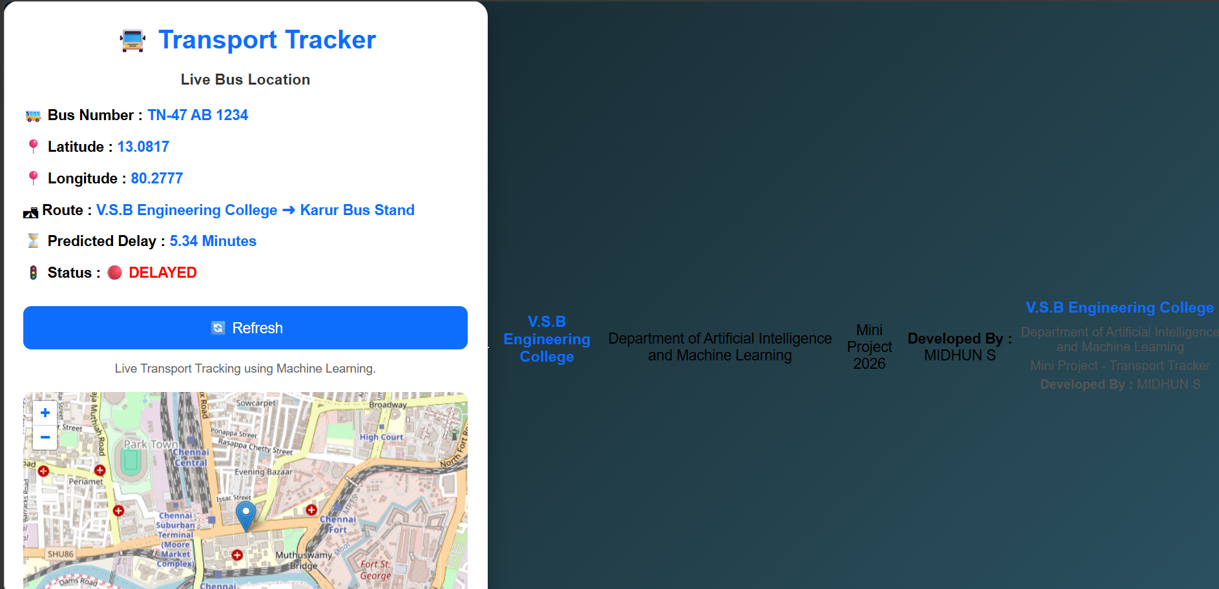
Live Demo
Transport Tracker dashboard in action
Real-Time Public Transport Tracking
11

Slide 12
How It Works
End-to-end methodology
GPS Input
Data Sent to Flask
ML Predicts Delay
Dashboard Updates
Commuter Informed
Refresh triggers a new request cycle — the map, delay, and status update live without reloading the page.
Real-Time Public Transport Tracking
12

Slide 13


Advantages
Why this solution fits small cities
Low-Cost Deployment
Predictive, Not Just Reactive
Built entirely on open-source tools — no expensive infrastructure required
ML-based delay prediction gives commuters advance warning, not just current position
Lightweight & Accessible
Scalable Design
Simple web dashboard runs on any browser or basic smartphone
Modular backend/frontend/model structure makes it easy to extend to more routes
Real-Time Public Transport Tracking
13

Slide 14
Future Scope
Where this project can go next
Real GPS hardware integration on live buses instead of simulated data
Dedicated Android/iOS app with push notifications for delays
Advanced ML models (LSTM/time-series) for more accurate delay forecasting
Multi-route, multi-city support with a unified transport authority dashboard
Real-Time Public Transport Tracking
14

Slide 15
Thank You
Real-Time Public Transport Tracking for Small Cities
V.S.B Engineering College — Department of AI & ML
Developed by: MIDHUN S

